Slide 1
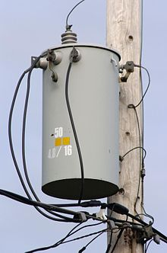
Transmission of Electricity
This lesson will introduce you to the concepts associated with the transmission of electrical energy and electricity
You will also learn about an electrical device used to regulate the amount of electricity entering your home.

Slide 2
Learning Goals
By the end of this lesson, you will be able to:
explain the power grid
name the two types of substations
name the two types of electrical transformers
solve problems involving transformers

Slide 3
Success Criteria
Can I:
explain how electricity moves through the power grid
name the two types of substations
name the two types of electrical transformers
solve problems involving transformers

Slide 4
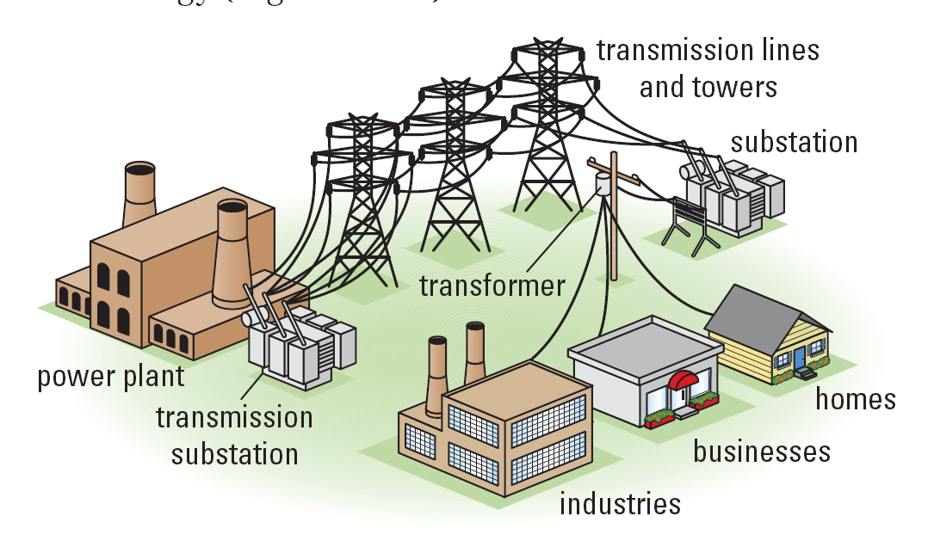
The Power Grid

Slide 5
a power plant produces electricity at 11 – 22 kV
this voltage is not high enough to transmit electricity
long distances efficiently
a transmission substation, near the power plant,
increases the voltage to 500 kV
the electrical energy is then transmitted long
distances at high voltage
However, 500,000 V can not be used safely in your
home

Slide 6
a power substation reduces the high voltage to a safe level of 240 and 120 V
a transformer is used to increase or decrease the voltage

Slide 7
The Transformer
a transformer is a device that uses EM induction to change voltage
a transformer consists of a soft iron core with two coils of wire.
current supplied to the primary coil induces a current to flow in the secondary coil.
by varying the # of coils in the primary and secondary
the voltage is either increased or decreased

Slide 8
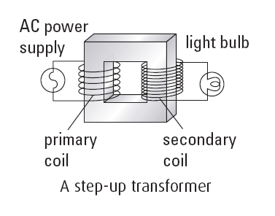
a transformer with more windings on the secondary coil increases the voltage and is known as step-up transformer.

Slide 9
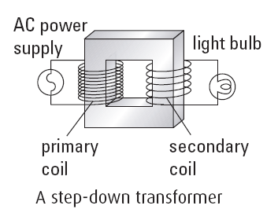
a transformer with more windings on the primary coil decreases the voltage and is known as step-down transformer.

Slide 10
the rel between the voltage and the number of turns
on the primary and secondary coil is:
where V_{p} = primary voltage.
V_{s} = secondary voltage.
N_{p} = # of turns primary coil
N_{s} = # of turns secondary coil
the rel between the current and the coils
where I_{p} = primary current
I_{s} = secondary current
N_{p} = # of turns primary coil
N_{s} = # of turns secondary coil

Slide 11
combining these two eqns we get:
Rearranging this equation we get:
but
so:

Slide 12
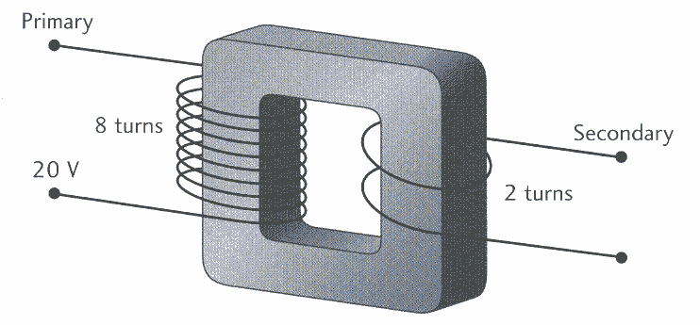
Sample Problem
For the transformer below:
a. determine the type.
b. if the input voltage is 20. V, what is the output
voltage?
c. What is the output current if the power
dissipated in the primary coil is 100. W

Slide 13
Sol’n a:
step-down transformer.
Sol’n b:
V_{p} = 20. V
N_{p} = 8 turns
N_{s} = 2 turns
V_{s} = ?
∴ secondary voltage is 5.0 V
Sol’n c:
V_{p} = 20. V
N_{p} = 8 turns
N_{s} = 2 turns
I_{s} = ?
∴ secondary current is 20. A

Slide 14
CONGRATULATIONS
YOU HAVE COMPLETED
SPH3U!

Slide 15
HOMEWORK
Read Section 13.5 and 13.6
Review Tutorials in the sections
Questions 1 – 2 pg 608
1 – 9 pg 609

